Slide 1
Counting-the-Homeless
By: Our Group

Slide 2
Our Data
What is our Data? What could we use?
Our Unit of Observation- Counties
Our analysis- The effect of housing availability on homelessness
Our controls- minimum wage, median house price, unemployment rate, etc.
We also plan on placing certain controls, focused on minimum wage, unemployment rate, etc, and seeing if affordable housing programs affect the homelessness rate in certain cities comparatively differently from others.

Slide 3
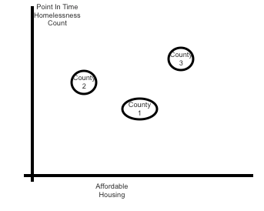
What we expect to find
Does affordable housing reduce homelessness rates?
-Controlling for other variables,
Do certain counties have more effective
affordable housing programs?

Slide 4
Our Deliverables
A shiny package that allows for new point in time count data to be imported and reanalyzed, so that counties can monitor the progress of their affordable housing programs in relation to another county in a quick manner.
Proposals of certain policy changes
What we expect to find in the future if these cities/counties grow at a certain rate (if their controlled variables change)

Slide 5
Future Analysis
Because of the lack of individual data we have, we would like to place further controls, or analyses of certain individuals and their responses as a function of certain types of government spending.
We believe that analyzing the difference between certain individuals in certain counties will provide a rich analysis as to which programs are most effective, while not biasing the report.

